Slide 1
BBM416 – Fundamentals of Computer Vision
Spring 2022

Slide 2
Previously on BBM416…

Slide 3
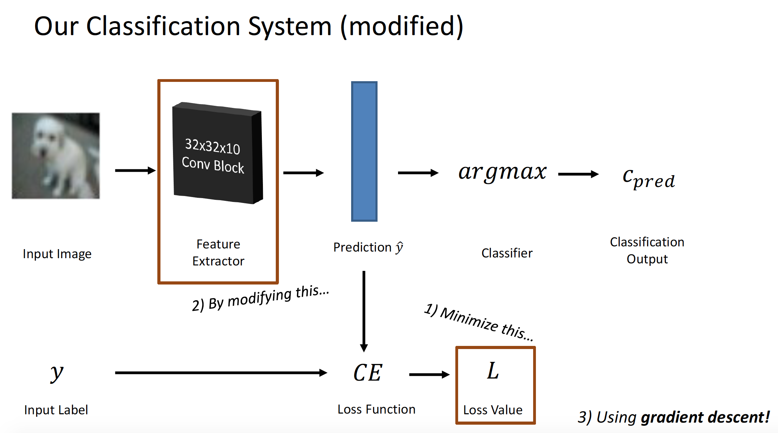

Slide 4
So what is deep (machine) learning?

Slide 5
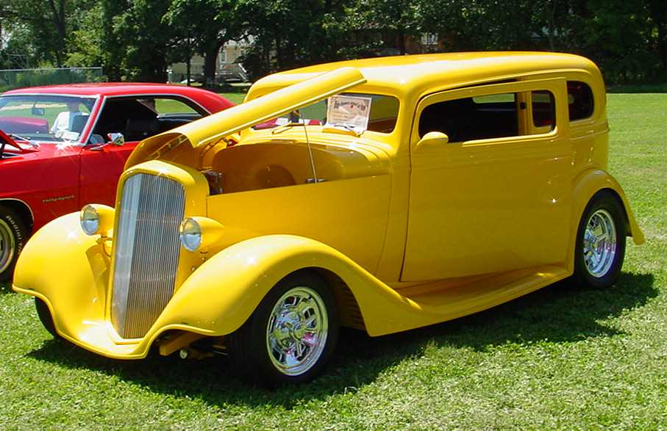
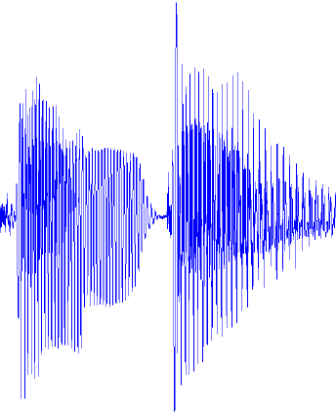
Traditional Machine Learning
VISION
hand-crafted features
SIFT/HOG
your favorite classifier
“car”
fixed
learned
SPEECH
hand-crafted features
MFCC
your favorite classifier
\ˈd ē p\
fixed
learned
NLP
hand-crafted features
Bag-of-words
your favorite classifier
This burrito place
is yummy and fun!
“+”
Yann LeCun
fixed
learned

Slide 6
Hierarchical Compositionality
VISION
pixels
edge
texton
motif
part
object
SPEECH
sample
spectral band
formant
motif
phone
word
NLP
character
word
NP/VP/..
clause
sentence
story
Slide by Dhruv Batra
Slide Credit: Marc'Aurelio Ranzato, Yann LeCun
Notes:
In most of these problems, there is not a simple jump from data to output. In hierarchical compositionality, the idea is to capture the compositional structure in building this mapping from data to the output. Eg, in vision, we know that edges form textons-.... Similarly in speech and NLP. NP=noun phrase, VP=verb phrase.

Slide 7
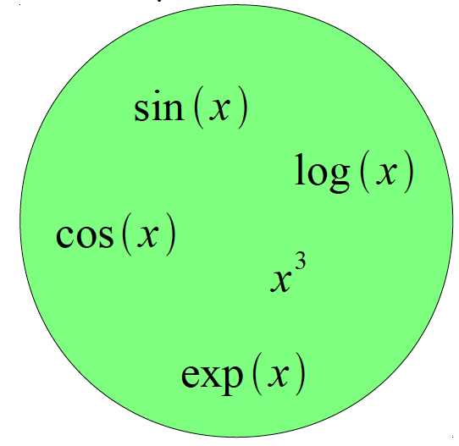
Building A Complicated Function
Given a library of simple functions
Compose into a
complicate function
Slide by Dhruv Batra
Slide Credit: Marc'Aurelio Ranzato, Yann LeCun
Notes:
As a motivational example for hierarchical compositionality, suppose I want to approximate a really complicated function. And I have a library of simple functions.

Slide 8
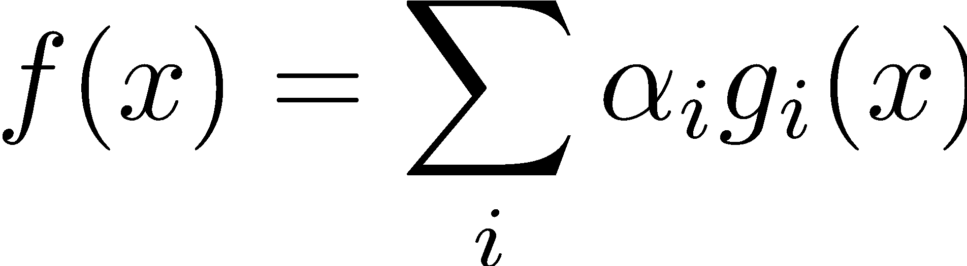
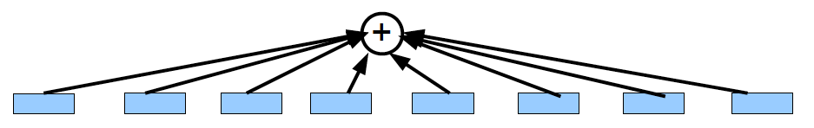
Building A Complicated Function
Given a library of simple functions
Idea 1: Linear Combinations
Boosting
Kernels
…
Compose into a
complicate function
Slide by Dhruv Batra
Slide Credit: Marc'Aurelio Ranzato, Yann LeCun
Notes:
Your first option is to build a flat, non-hierarchical (typically linear) composition of these functions. This is what traditional ML techniques, like SVM and boosting, basically do.

Slide 9
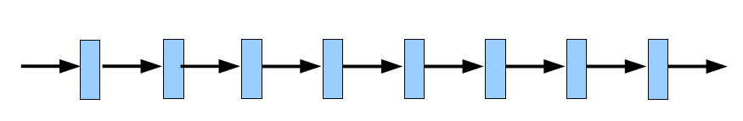
Building A Complicated Function
Given a library of simple functions
Idea 2: Compositions
Deep Learning
Grammar models
Scattering transforms…
Compose into a
complicate function
Slide by Dhruv Batra
Slide Credit: Marc'Aurelio Ranzato, Yann LeCun
Notes:
Second option is use a composition of these.

Slide 10
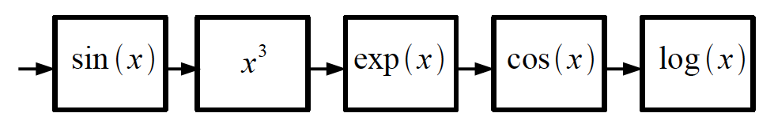
Building A Complicated Function
Given a library of simple functions
Idea 2: Compositions
Deep Learning
Grammar models
Scattering transforms…
Compose into a
complicate function
Slide by Dhruv Batra
Slide Credit: Marc'Aurelio Ranzato, Yann LeCun
Notes:
For example, you can compose it like this. Important: Each block cares about only its input. But from input to output we end up with a very complex function. This is an essential idea in deep learning, and other hierarchical model. In deep nets, we have many blocks like this in each layer, and we learn one simple function for each block, which leads to a very powerful class of models. In deep learning, I will not be using pre-defined blocks like this, but instead will learn these blocks

Slide 11
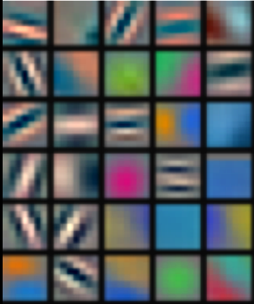
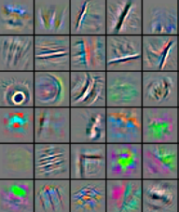
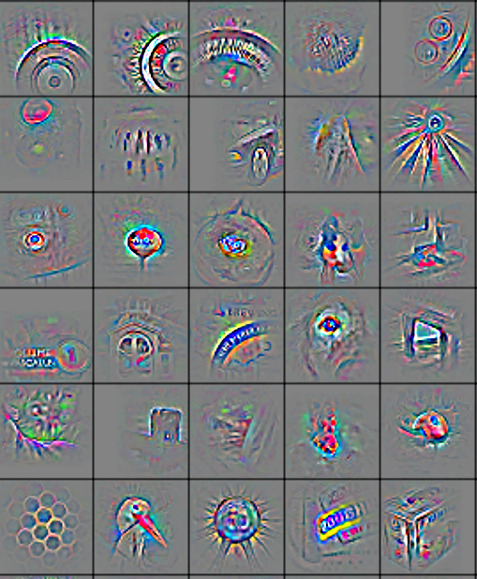
Deep Learning = Hierarchical Compositionality
Low-Level Feature
Mid-Level Feature
High-Level Feature
Trainable Classifier
“car”
Slide by Dhruv Batra
Feature visualization of convolutional net trained on ImageNet from [Zeiler & Fergus 2013]
Slide Credit: Marc'Aurelio Ranzato, Yann LeCun
Notes:
This looks into edges, progressively higher level structures, ultimately high-level compositions. What you learn in earlier layers are heavily reused in upper layers.

Slide 12
Traditional Machine Learning
VISION
hand-crafted features
SIFT/HOG
your favorite classifier
“car”
fixed
learned
SPEECH
hand-crafted features
MFCC
your favorite classifier
\ˈd ē p\
fixed
learned
NLP
hand-crafted features
Bag-of-words
your favorite classifier
This burrito place
is yummy and fun!
“+”
Yann LeCun
fixed
learned

Slide 13
Deep Learning = End-to-End Learning
VISION
“Learned”
SIFT/HOG
K-Means/
pooling
classifier
“car”
fixed
unsupervised
supervised
SPEECH
MFCC
Mixture of
Gaussians
classifier
\ˈd ē p\
fixed
unsupervised
supervised
NLP
Parse Tree
Syntactic
n-grams
classifier
This burrito place
is yummy and fun!
“+”
Yann LeCun
fixed
unsupervised
supervised

Slide 14
Why are things working today?
More compute power
GPUs are ~50x faster
More data
10⁸ samples (compared to 10³ in 1990s)
Better algorithms/models/regularizers
Dropout
ReLu
Batch-Normalization
…
Slide by Dhruv Batra
Notes:
Should take around 40 minutes up to here.

Slide 15
Artificial Neural Networks and Deep Learning

Slide 16
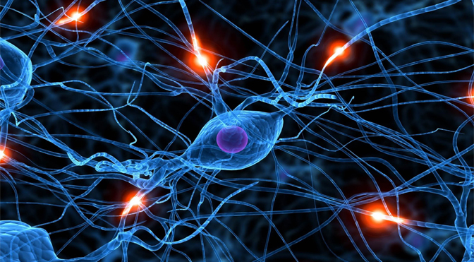

Neural Networks
Network in the brain
Artificial Neural Net

Slide 17
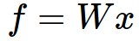
Neural Network: without the brain stuff
(Before) Linear score function:
Notes:
This is what we have been working for so far as the classifier.

Slide 18
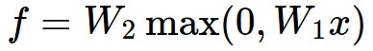
Neural Network: without the brain stuff
(Before) Linear score function:
(Now) 2-layer Neural Network
Notes:
In NNs, we'll make it more complex. We add one more matrix multiply, W2, and also an activation function. The activation here is a relu, which thresholds the output of the first matrix multiply at 0.

Slide 19
Neural Network: without the brain stuff
(Before) Linear score function:
(Now) 2-layer Neural Network
x
h
W1
W2
s
3072
100
10
Notes:
Here is one possible visualization. Data goes through W1 multiply, then Relu, then W2 multiply. Note that we have a 100-d vector in the middle (after ReLU). How is that useful?

Slide 20
Neural Network: without the brain stuff
(Before) Linear score function:
(Now) 2-layer Neural Network
or 3-layer Neural Network

Slide 21

Neural Networks: Architectures
“3-layer Neural Net”, or
“2-hidden-layer Neural Net”
“2-layer Neural Net”, or
“1-hidden-layer Neural Net”
“Fully-connected” layers
Notes:
We have the units, and the act functions. We organize them to build neural networks. Here are two examples "2-layer NN" and "3-layer NN". Input layer is not counted. These are called fully-connected since each neuron connects to all other neurons in the previous layer.

Slide 22

Setting the number of layers and their sizes
more neurons = more capacity
Notes:
Increasing # neurons, increses the capacity of the neural network. (1 hidden layer)

Slide 23
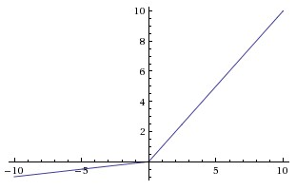
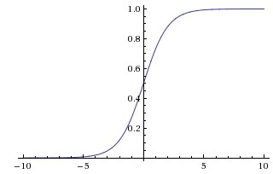
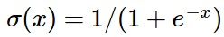
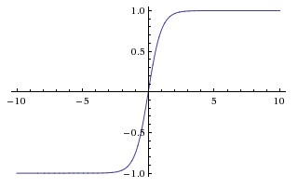
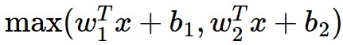
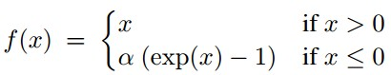
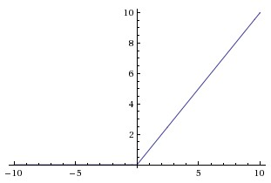
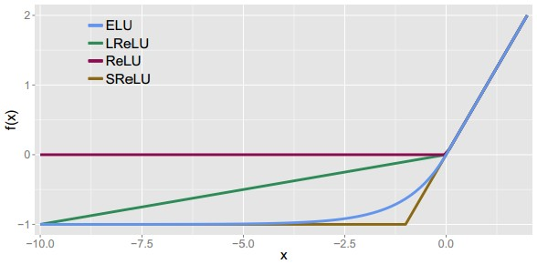
Activation Functions
Leaky ReLU
max(0.1x, x)
Sigmoid
Maxout
tanh tanh(x)
ELU
ReLU max(0,x)
Notes:
ReLU is the most commonly used one. ELU = “Exponential Linear Unit”. There are many other, several recently proposed.We'll talk about these later.

Slide 24
Activation Functions
Squashes numbers to range [0,1]
Historically popular since they have nice interpretation as a saturating “firing rate” of a neuron
3 problems:
Saturated neurons “kill” the gradients
Sigmoid outputs are not zero-centered
exp() is a bit compute expensive
Sigmoid
Notes:
Third problem with exp() is its slow. But not a big deal: most time goes into convolutions, not activations.

Slide 25
Activation Functions
Squashes numbers to range [-1,1]
zero centered (nice)
still kills gradients when saturated :(
tanh(x)
[LeCun et al., 1991]
Notes:
tanh fixed the non-centered problem. Yann LeCun suggested tanh as a replacement of sigmoid. But you still have vanishing gradient problem. (In general, tanh is preferable to sigmoid)

Slide 26
Activation Functions
Computes f(x) = max(0,x)
Does not saturate (in +region)
Very computationally efficient
Converges much faster than sigmoid/tanh in practice (e.g. 6x)
Not zero-centered output
An annoyance:
hint: what is the gradient when x < 0?
ReLU
(Rectified Linear Unit)
Notes:
But it is not still perfect: (1) not zero-centered, (2) still kills the gradient 50% of time (if it is inactive in the fwd pass)

Slide 27

Introduction to ConvNets
[LeNet-5, LeCun 1998]
Notes:
https://youtu.be/KaR4lIdI1MQ?t=3451 @ 57:00

Slide 28
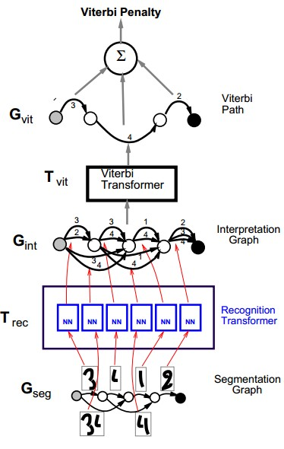
A bit of history:
Gradient-based learning applied to document recognition
[LeCun, Bottou, Bengio, Haffner 1998]
LeNet-5
Notes:
Yann LeCun put it further by adding back-prop into it.
They've built a complex system that can read cheques but it was sort of small

Slide 29
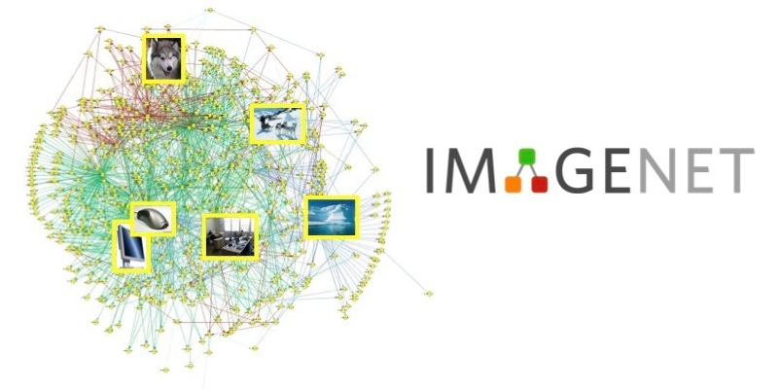

A bit of history:
ImageNet Classification with Deep Convolutional Neural Networks
[Krizhevsky, Sutskever, Hinton, 2012]
“AlexNet”
Notes:
In 2012, ConvNets became quite large and trained over a large number of ImageNet examples
There are very few differences compared to LeCun:
Tanh/sigmoids -> relu
Bigger, deeper
On GPU, more data
Of course, now we have better sgd, we have batchnorm, better initialize but overall idea is pretty much the same. The crucial thing is to scale it up.

Slide 30
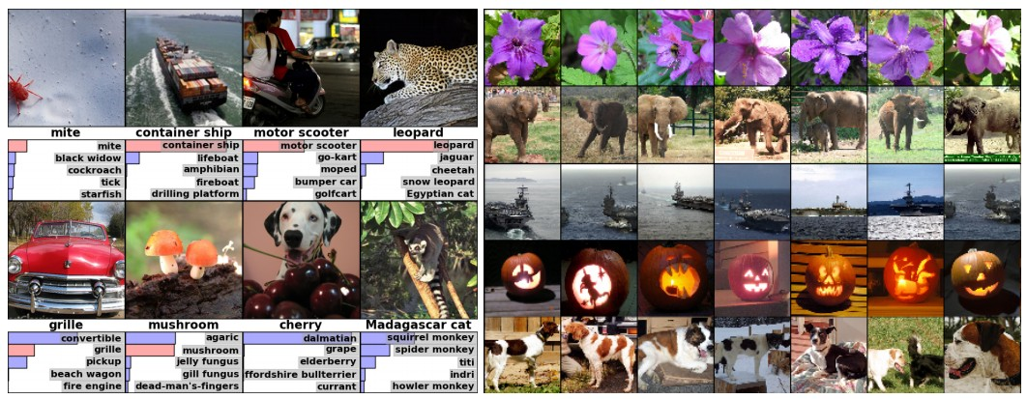
Fast-forward to today: ConvNets are everywhere
Classification
Retrieval
[Krizhevsky 2012]
Notes:
ConvNets are everywhere, very good at classify, retrieval

Slide 31
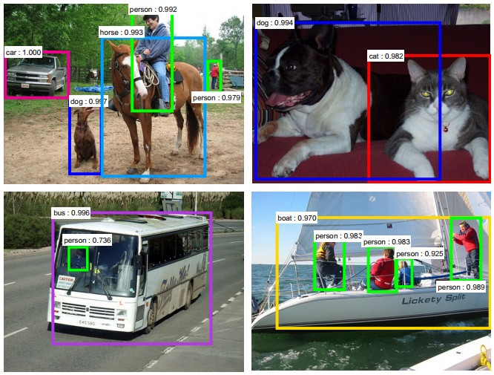
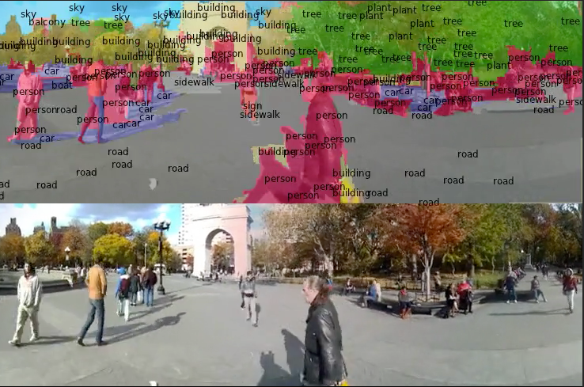
Fast-forward to today: ConvNets are everywhere
Detection
Segmentation
[Faster R-CNN: Ren, He, Girshick, Sun 2015]
[Farabet et al., 2012]
Notes:
Detection, semantic segmentation (every pixel is labelled)

Slide 32
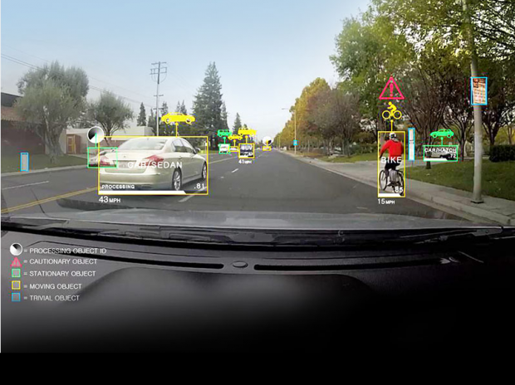
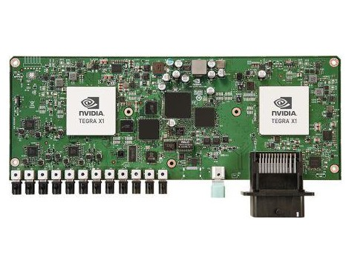
Fast-forward to today: ConvNets are everywhere
NVIDIA Tegra X1
self-driving cars
Notes:
On Cars for safe-driving

Slide 33
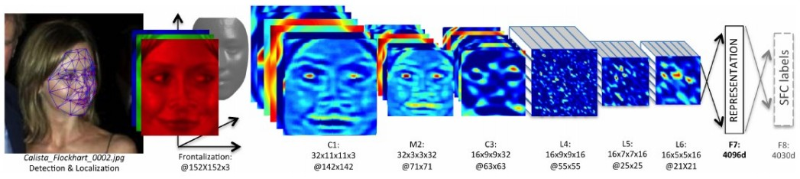
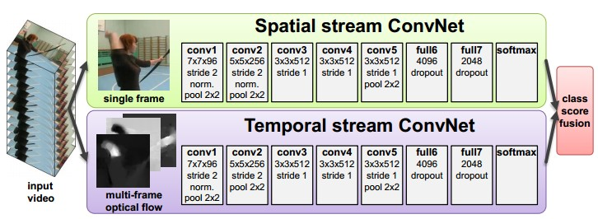
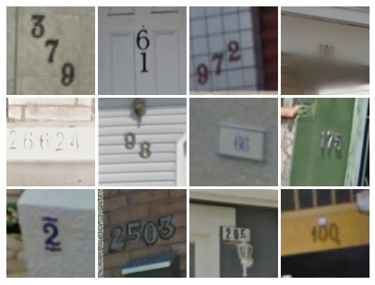
Fast-forward to today: ConvNets are everywhere
[Taigman et al. 2014]
[Goodfellow 2014]
[Simonyan et al. 2014]
Notes:
Facebook automatically tags your friends on images
Used for event recognition in videos
Google used convnets for reading house numbers in street view images. Lots of supervised data, good for geo-localization of images.

Slide 34
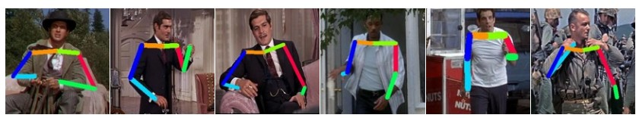
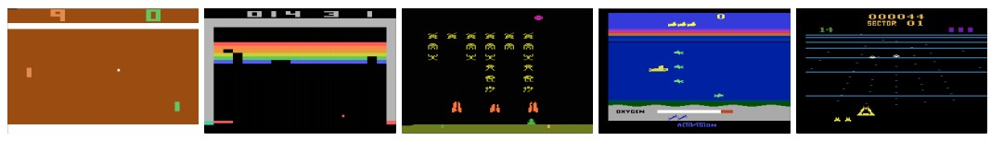
Fast-forward to today: ConvNets are everywhere
[Toshev, Szegedy 2014]
[Mnih 2013]
Notes:
They can estimate poses
They can play games

Slide 35
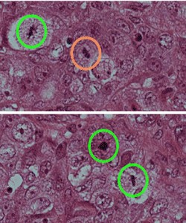
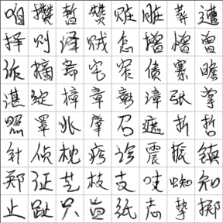
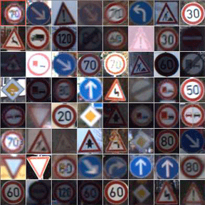
Fast-forward to today: ConvNets are everywhere
[Ciresan et al. 2013]
[Sermanet et al. 2011]
[Ciresan et al.]
Notes:
Many recent papers look into medical image analysis based on convnets
They can read characters and symbols and signals

Slide 36
Details of
Convolutional Neural Networks
Notes:
Now that we're done with re-marketing of convnets, we can talk about its details

Slide 37
Convolution Layer
32x32x3 image
32
height
32
width
3
depth
Notes:
So start off with some image, like 32x32x3 of CIFAR
ConvNets operate on tensors, volumes not vectors (unlike neural networks), they produce volumes
ConvLayer is the building block of ConvNet

Slide 38
Convolution Layer
32x32x3 image
5x5x3 filter
32
Convolve the filter with the image
i.e. “slide over the image spatially, computing dot products”
32
3
Notes:
We receive some input to the layer
And we'll have all these little filters in the layer
Suppose we have a single filter.
These filters will be small spatially. For example, here it is spatially only 5x5 but it spans 3 depths of the input volume.

Slide 39
Convolution Layer
Filters always extend the full depth of the input volume
32x32x3 image
5x5x3 filter
32
Convolve the filter with the image
i.e. “slide over the image spatially, computing dot products”
32
3
Notes:
It always covers the whole depth of the input volume
What we'll do is to convole the image with the filter
You may know or have forgotten convolving from your signal processing class but here what it really is: we slide the filter over the image spatially, and at each location, compute a dot product between the numbers in the input sub-volume and the filter
The numbers on the filter are called coefficients

Slide 40

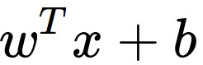
Convolution Layer
32x32x3 image
5x5x3 filter
32
1 number:
the result of taking a dot product between the filter and a small 5x5x3 chunk of the image
(i.e. 5*5*3 = 75-dimensional dot product + bias)
32
3
Notes:
X = is a piece of your input volume
W = vectorized coefficients of filter
At each location during sliding, you do a 75d dot product. You typically also have a bias term associated with the filter.

Slide 41
Convolution Layer
activation map
32x32x3 image
5x5x3 filter
32
28
convolve (slide) over all spatial locations
32
28
3
1
Notes:
As you slide the filter over the image and compute dot prodcts, you get an activation map of size 28x28.
Why 28? There are 28 unique positions that we can place the filter.We'll talk about this later.

Slide 42
consider a second, green filter
Convolution Layer
32x32x3 image
5x5x3 filter
activation maps
32
28
convolve (slide) over all spatial locations
32
28
3
1
Notes:
In real convlayers, we don't have a single filter but an entire set of filters.
Each one is separately slided over the whole image

Slide 43
For example, if we had 6 5x5 filters, we’ll get 6 separate activation maps:
activation maps
32
28
Convolution Layer
32
28
3
6
We stack these up to get a “new image” of size 28x28x6!
Notes:
If we have 6 filters, we have 6 activation maps, which results in an output of size 28x28x6

Slide 44
Preview: ConvNet is a sequence of Convolution Layers, interspersed with activation functions
32
28
CONV,
ReLU
e.g. 6 5x5x3 filters
32
28
3
6
Notes:
We'll have a stack of such conv-layers to have a convnet
The output of a convlayer (a linear transform) is provided into a non0linear activation function
The output volume of the act function is given as an input to the next conv layer

Slide 45
Preview: ConvNet is a sequence of Convolutional Layers, interspersed with activation functions
32
28
24
….
CONV,
ReLU
e.g. 6 5x5x3 filters
CONV,
ReLU
e.g. 10 5x5x6 filters
CONV,
ReLU
32
28
24
3
6
10
Notes:
Now the filters in the second layer have 6 channels, since the input volume has 6 channels. Each filter is 5x5x6
Suppose we have 10 filters in the second layer, then the output of the second conv-layer is 24x24x10

Slide 46

Preview
[From recent Yann LeCun slides]
Notes:
We'll initialize these filters randomly, these are parameters of the convnet and learn them from a filter
This visualizes the convlayers learned on a dataset. Early convlayers contain simple structures like edges an so on.
The second layer operates by computing dot-products on the outputs of the first conv-layer.
These filters get excited with things like circles, etc
As we go deeper in the hierarc1hy, we'll build filters that recognize things like honeycombs and so on.
Note that these are all learned by optiization, starting from pure random filters
Also note that the upper-most layer is still 5x5 but it operates on the outputs of the previous conv layers. Therefore, they effectively look at larger regions of the original image.

Slide 47

preview:
Notes:
ConvNets typically have a lay-out like this
A conv layer, rect layer (basically a truncation-threshold on the activation), pooling
Here we visualize the outputs
We'll talk about pooling in a minute
Go from left-to-right
At the end, we provide a standard fully-connected NN layer that takes all the activations of the previous conv layer and converts them into a class probability scores

Slide 48
A closer look at spatial dimensions:
activation map
32x32x3 image
5x5x3 filter
32
28
convolve (slide) over all spatial locations
32
28
3
1
Notes:
More detail why 32->28 for 5x5 fileter

Slide 49
A closer look at spatial dimensions:
7
7x7 input (spatially)
assume 3x3 filter
7
Notes:
Lets assume that our input volume is 7x7x1 and filter is 3x3x1.

Slide 50
A closer look at spatial dimensions:
7
7x7 input (spatially)
assume 3x3 filter
7
Notes:
slide

Slide 51
A closer look at spatial dimensions:
7
7x7 input (spatially)
assume 3x3 filter
7

Slide 52
A closer look at spatial dimensions:
7
7x7 input (spatially)
assume 3x3 filter
7

Slide 53
A closer look at spatial dimensions:
7
7x7 input (spatially)
assume 3x3 filter
=> 5x5 output
7
Notes:
There are 5 horizontal places that I can place, overall 5^2 unique places.

Slide 54
A closer look at spatial dimensions:
7
7x7 input (spatially)
assume 3x3 filter
applied with stride 2
7
Notes:
Stride 2 ...

Slide 55
A closer look at spatial dimensions:
7
7x7 input (spatially)
assume 3x3 filter
applied with stride 2
7

Slide 56
A closer look at spatial dimensions:
7
7x7 input (spatially)
assume 3x3 filter
applied with stride 2
=> 3x3 output!
7
Notes:
3x3

Slide 57
A closer look at spatial dimensions:
7
7x7 input (spatially)
assume 3x3 filter
applied with stride 3?
7
Notes:
Stride 3?

Slide 58
A closer look at spatial dimensions:
7
7x7 input (spatially)
assume 3x3 filter
applied with stride 3?
7
doesn’t fit!
cannot apply 3x3 filter on 7x7 input with stride 3.
Notes:
Doesn't fit equally. You may get results for it, but, for the purposes of the class, we can simply say that it doesn't fit

Slide 59
N
Output size:
(N - F) / stride + 1
e.g. N = 7, F = 3:
stride 1 => (7 - 3)/1 + 1 = 5
stride 2 => (7 - 3)/2 + 1 = 3
stride 3 => (7 - 3)/3 + 1 = 2.33 :\
F
N
F
Notes:
This formula basically tells us the spatial size of the output volume for given input size and filter size
Stride 3 -> doesn't fit for our purposes.

Slide 60
In practice: Common to zero pad the border
0 | 0 | 0 | 0 | 0 | 0
0
0
0
0
e.g. input 7x7
3x3 filter, applied with stride 1
pad with 1 pixel border => what is the output?
(recall:)
(N - F) / stride + 1
Notes:
It is very common to pad the input
Let's see why it is useful in practice

Slide 61
In practice: Common to zero pad the border
0 | 0 | 0 | 0 | 0 | 0
0
0
0
0
e.g. input 7x7
3x3 filter, applied with stride 1
pad with 1 pixel border => what is the output?
7x7 output!
Notes:
Output size = input size
Very practical, you don't want to think to too much about the sizes when designing architectures. It is very convenient to preserve the spatial size, to avoid nasty tuning of filter sizes when playing with the layer configuration.

Slide 62
In practice: Common to zero pad the border
0 | 0 | 0 | 0 | 0 | 0
0
0
0
0
e.g. input 7x7
3x3 filter, applied with stride 1
pad with 1 pixel border => what is the output?
7x7 output!
in general, common to see CONV layers with stride 1, filters of size FxF, and zero-padding with (F-1)/2. (will preserve size spatially)
e.g. F = 3 => zero pad with 1
F = 5 => zero pad with 2
F = 7 => zero pad with 3
Notes:
Use (f-1)/2 to preserve size spatially

Slide 63
Remember back to…
E.g. 32x32 input convolved repeatedly with 5x5 filters shrinks volumes spatially!
(32 -> 28 -> 24 ...). Shrinking too fast is not good, doesn’t work well.
32
28
24
….
CONV,
ReLU
e.g. 6 5x5x3 filters
CONV,
ReLU
e.g. 10 5x5x6 filters
CONV,
ReLU
32
28
24
3
6
10
Notes:
If you don't do padding, size shrinks over layers. Very quick decrease → limits the #layers in our model

Slide 64
Examples time:
Input volume: 32x32x3
10 5x5 filters with stride 1, pad 2
Output volume size: ?

Slide 65
Examples time:
Input volume: 32x32x3
10 5x5 filters with stride 1, pad 2
Output volume size:
(32+2*2-5)/1+1 = 32 spatially, so
32x32x10

Slide 66
Examples time:
Input volume: 32x32x3
10 5x5 filters with stride 1, pad 2
Number of parameters in this layer?

Slide 67
Examples time:
Input volume: 32x32x3
10 5x5 filters with stride 1, pad 2
Number of parameters in this layer?
each filter has 5*5*3 + 1 = 76 params (+1 for bias)
=> 76*10 = 760

Slide 68
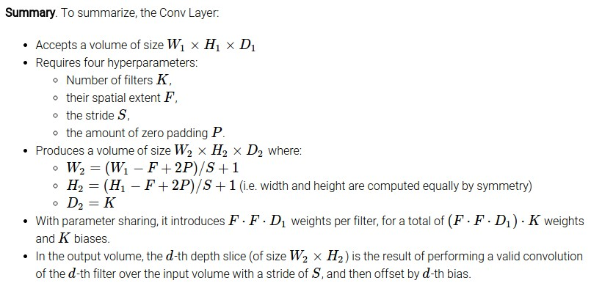
Notes:
Always accept a volume of size WxHxD
Produces a volume of size W2xH2xD2
Conv layer 4 hyper-parameters:...
F is usually odd since even has a weird filter center

Slide 69
Common settings:
K = (powers of 2, e.g. 32, 64, 128, 512)
F = 3, S = 1, P = 1
F = 5, S = 1, P = 2
F = 5, S = 2, P = ? (whatever fits)
F = 1, S = 1, P = 0
Notes:
Total number of parameters that we use
K is usually a power of two (which is treated specially in some libraries)
Top-right examples are common settings: 1,2) P preserves size, 3) larger stride

Slide 70
(btw, 1x1 convolution layers make perfect sense)
1x1 CONV
with 32 filters
56
56
(each filter has size 1x1x64, and performs a 64-dimensional dot product)
56
56
64
32
Notes:
Sometimes people are confused when they see 1x1 conv
But remmeber that each filter operates through the whole volume!
Every filter here does a 64-dimensions dot product, through the depth of the input volume
No spatial processing
Aka = depth column = fiber
Karpathy: 12+29=37 minutes up to here, including this slide + questions (12+24 without questions)

Slide 71
The brain/neuron view of CONV Layer
32x32x3 image
5x5x3 filter
32
1 number:
the result of taking a dot product between the filter and this part of the image
(i.e. 5*5*3 = 75-dimensional dot product)
32
3
Notes:
Brain-neuron view of conv-layer
A filter, at each position, computes a dot product
8.3.2017 1h lecture stopped here.

Slide 72

The brain/neuron view of CONV Layer
32x32x3 image
5x5x3 filter
32
It’s just a neuron with local connectivity...
1 number:
the result of taking a dot product between the filter and this part of the image
(i.e. 5*5*3 = 75-dimensional dot product)
32
3
Notes:
A neuron, fixed in space, computing the dot product. This is what we do at each location when convolving with a filter.
Receptive field = region a neuron is looking at, local connectivity

Slide 73
The brain/neuron view of CONV Layer
32
28
An activation map is a 28x28 sheet of neuron outputs:
Each is connected to a small region in the input
All of them share parameters
“5x5 filter” -> “5x5 receptive field for each neuron”
32
28
3
Notes:
A filter shares parameters across the locations
Single channel of a conv layer = a grid of neurons with exactly same functionality

Slide 74
The brain/neuron view of CONV Layer
32
E.g. with 5 filters,
CONV layer consists of neurons arranged in a 3D grid
(28x28x5)
There will be 5 different neurons all looking at the same region in the input volume
28
32
28
3
5
Notes:
We have several filters in each conv filter
3D grids of neurons, spatially weights are shared but not through the output filter

Slide 75
two more layers to go: POOL/FC
Notes:
We'll talk now about POOL and FC

Slide 76

Pooling layer
makes the representations smaller and more manageable
operates over each activation map independently:
Notes:
Pooling layer = take input volume and squash it spatially
Typically independent over activation maps independenty

Slide 77
MAX POOLING
Single depth slice
1 | 1 | 2 | 4
5 | 6 | 7 | 8
3 | 2 | 1 | 0
1 | 2 | 3 | 4
x
max pool with 2x2 filters and stride 2
6 | 8
3 | 4
y
Notes:
Most commonly used..
Take max of 2x2 pieces
Average pooling
Becoming less popular over time, these days more and more models use stride-2 convolutions, rather than max-pooling

Slide 78
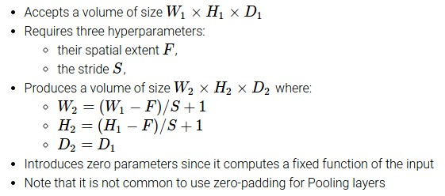
Notes:
You need to decide spatial extend F and stride S
Common numbers

Slide 79
Common settings:
F = 2, S = 2
F = 3, S = 2
Notes:
Depth is unchanged

Slide 80
Fully Connected Layer (FC layer)
Contains neurons that connect to the entire input volume, as in ordinary Neural Networks
Notes:
Pool: 32 -> 16 -> 8 -> 4
Convert last volume into a giant vector, then FC = matrix multiply
Each neuron in FC is connected to all values in the input volume.

Slide 81
[ConvNetJS demo: training on CIFAR-10]
http://cs.stanford.edu/people/karpathy/convnetjs/demo/cifar10.html
Notes:
Trains ConvNet in the browser
Can load pretrained network
Karpathy = 12+39 minutes up to here (including the demo)

Slide 82
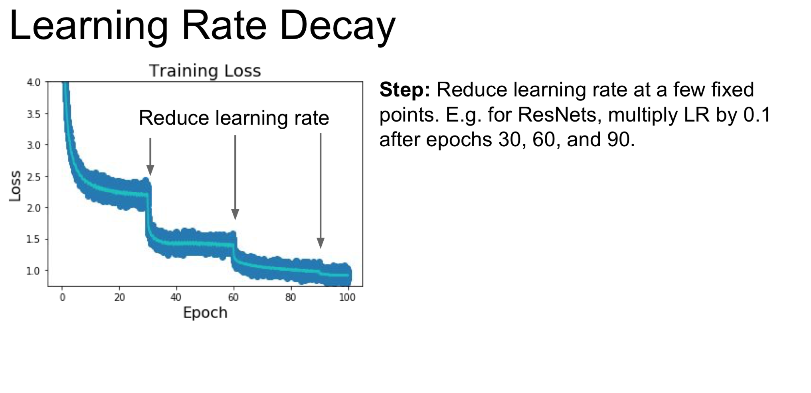

Slide 83
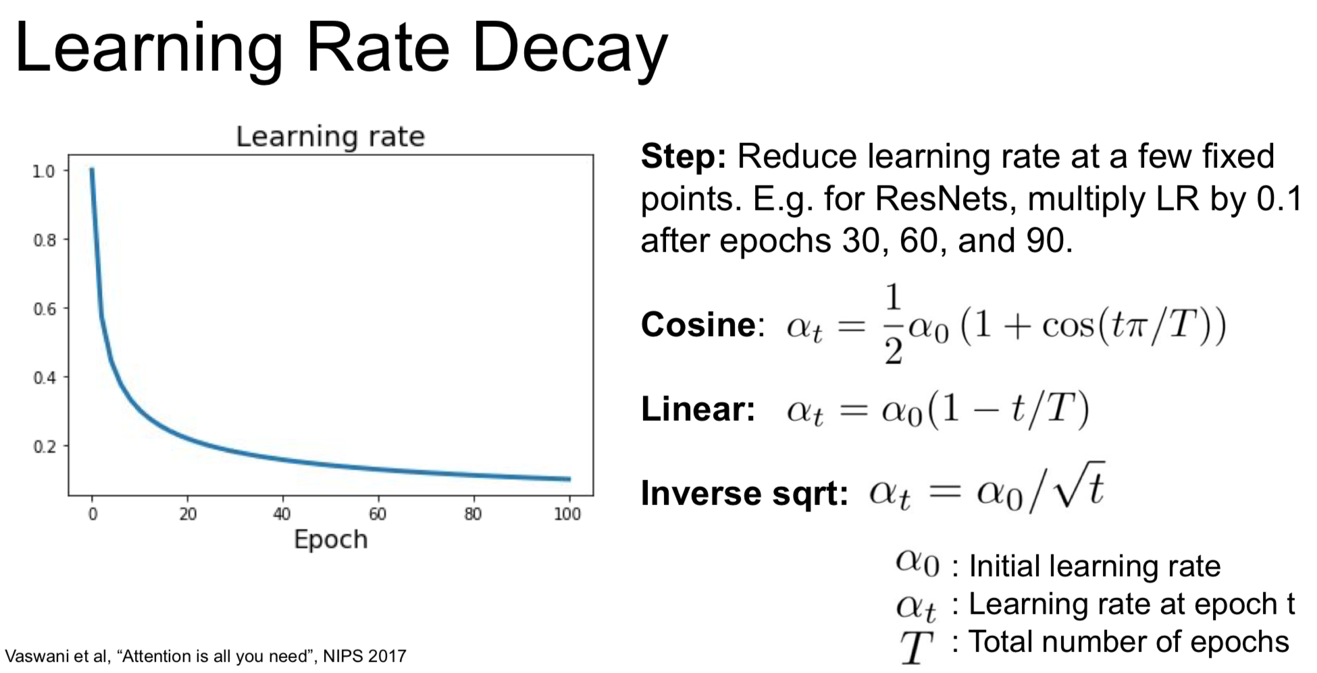

Slide 84
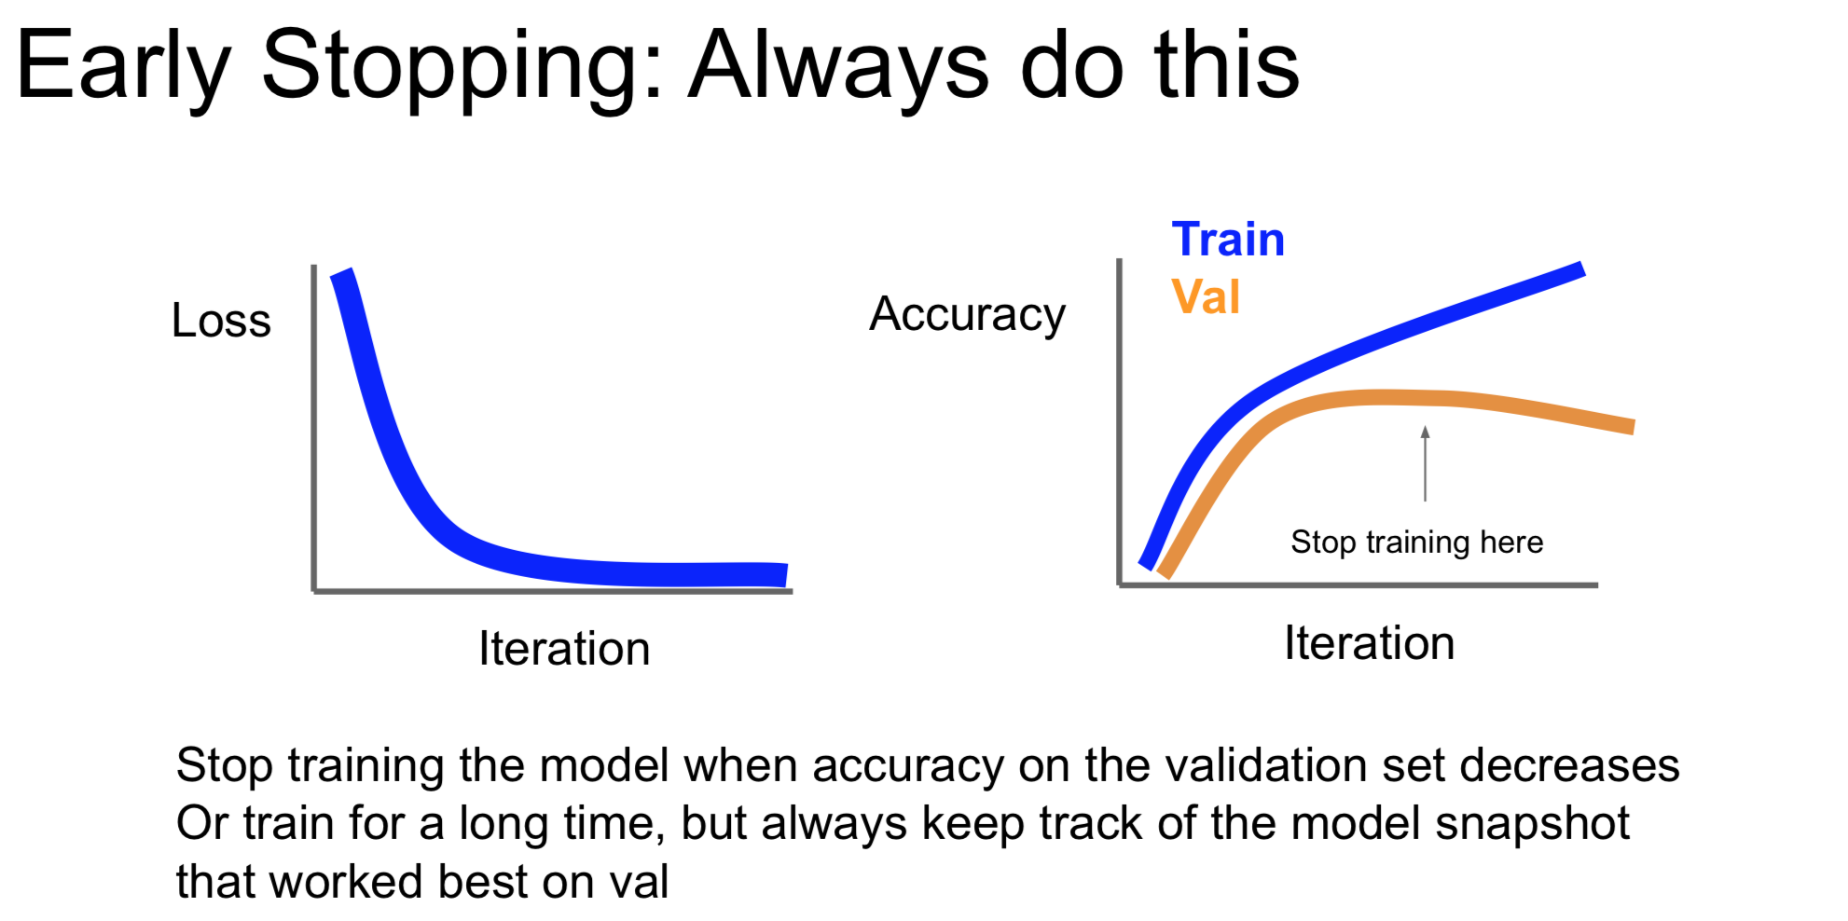

Slide 85
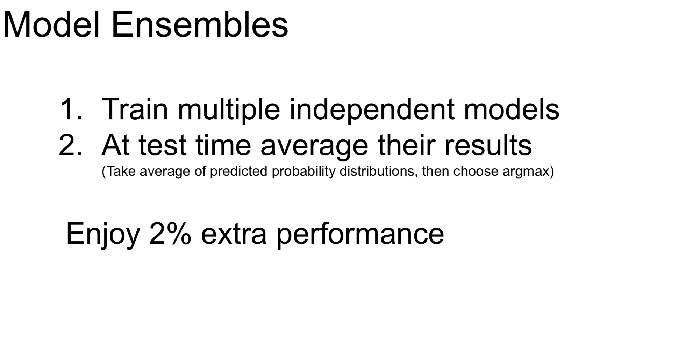

Slide 86
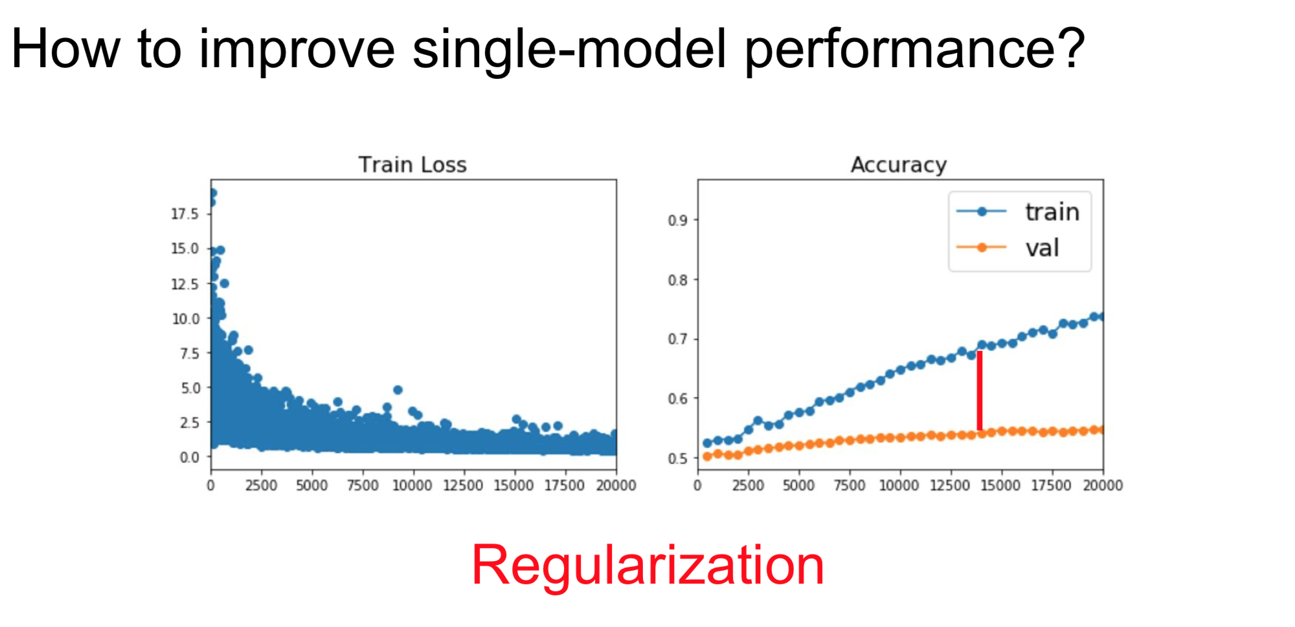

Slide 87
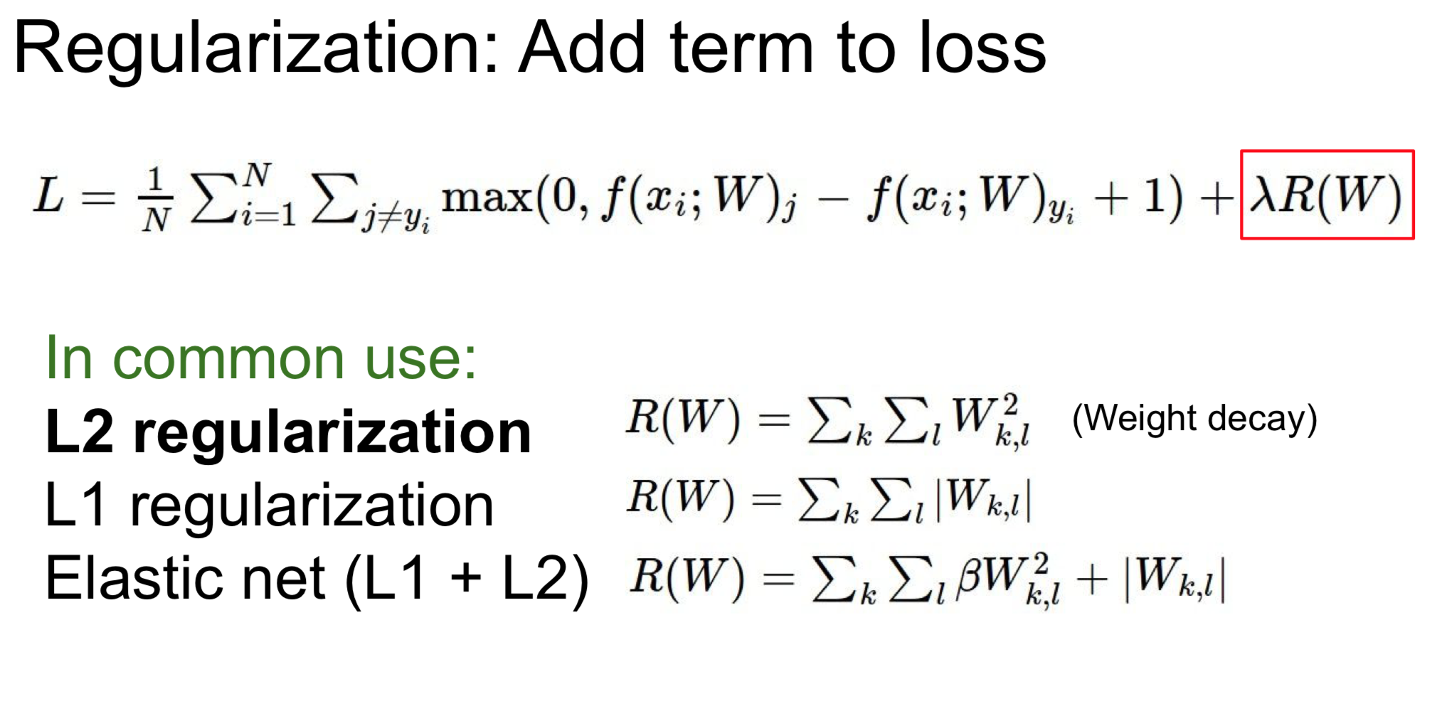

Slide 88
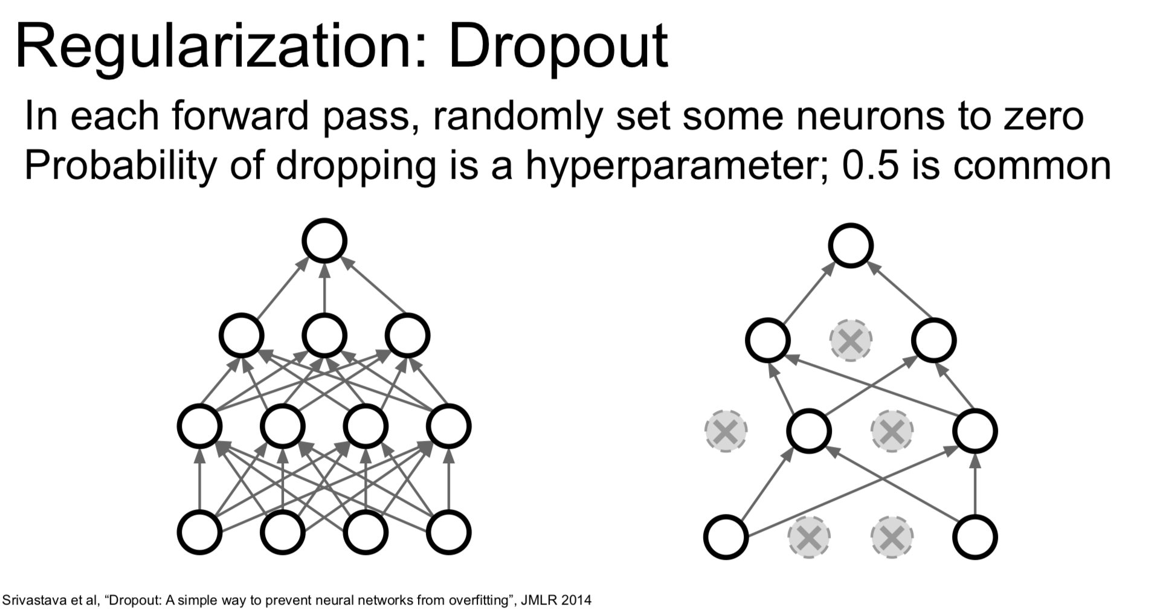

Slide 89
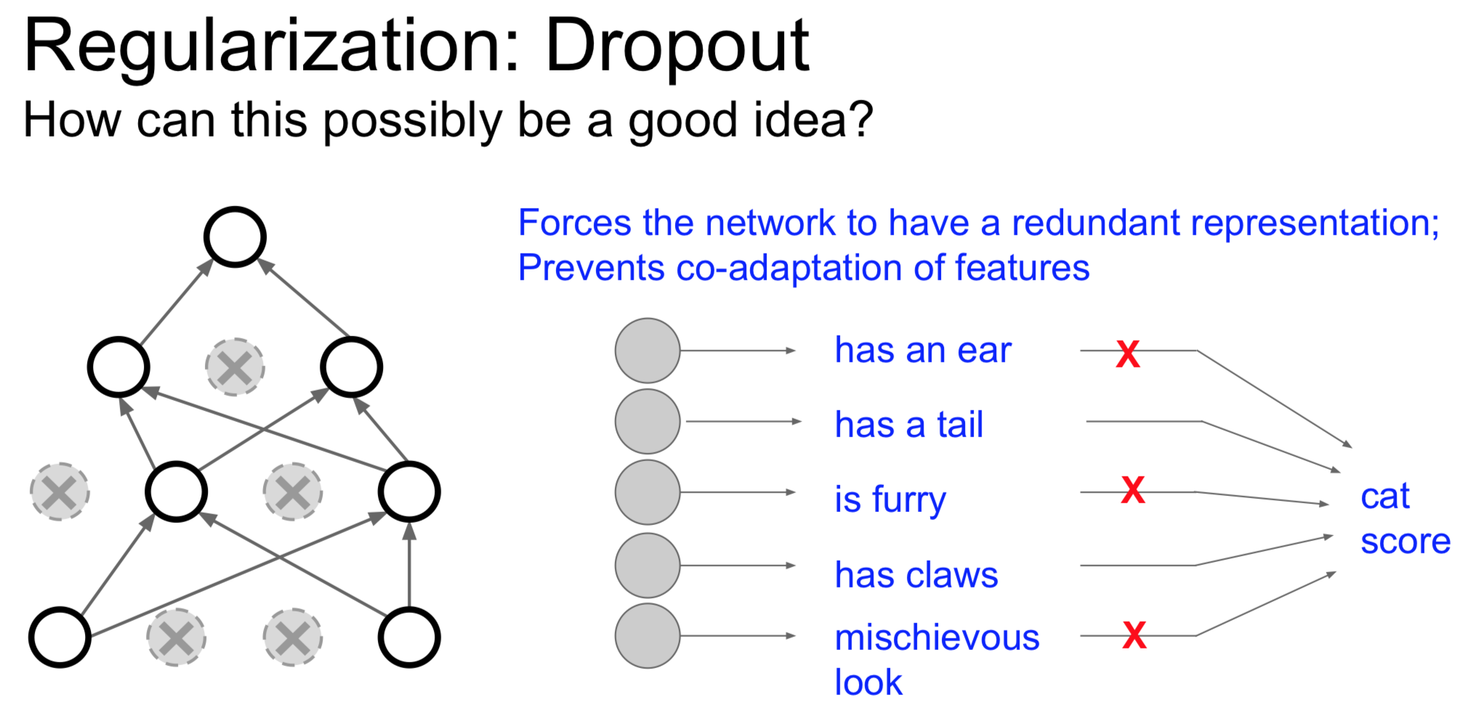

Slide 90
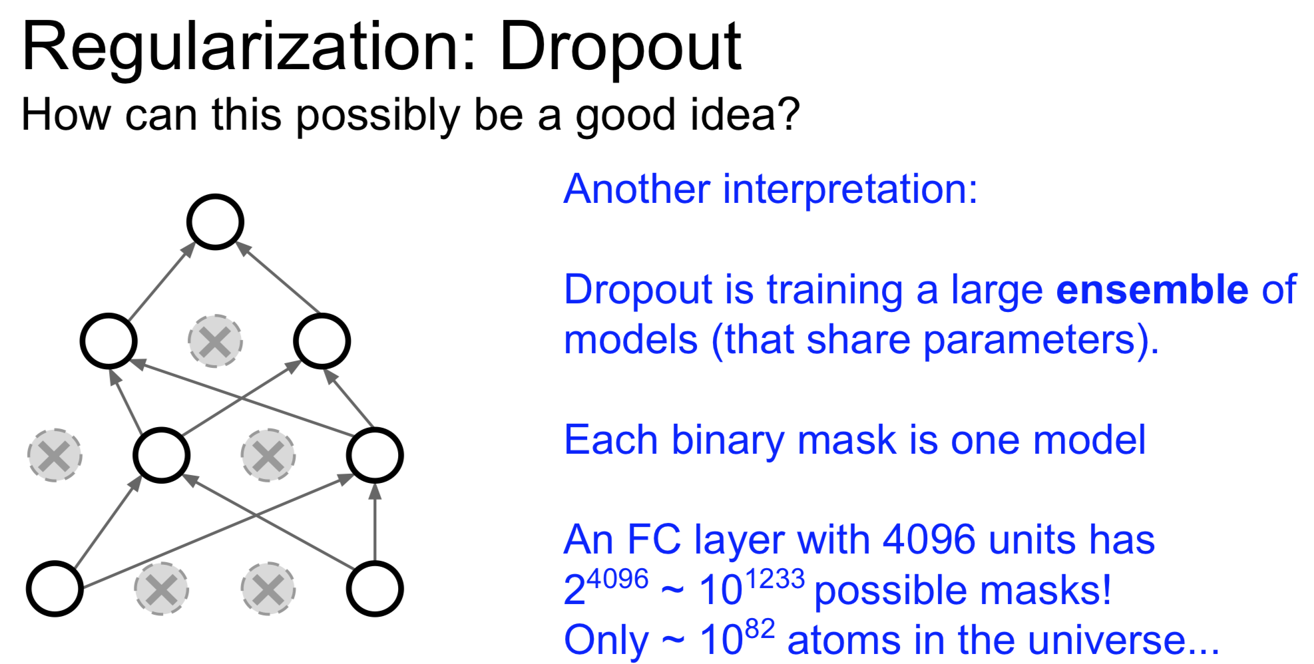

Slide 91
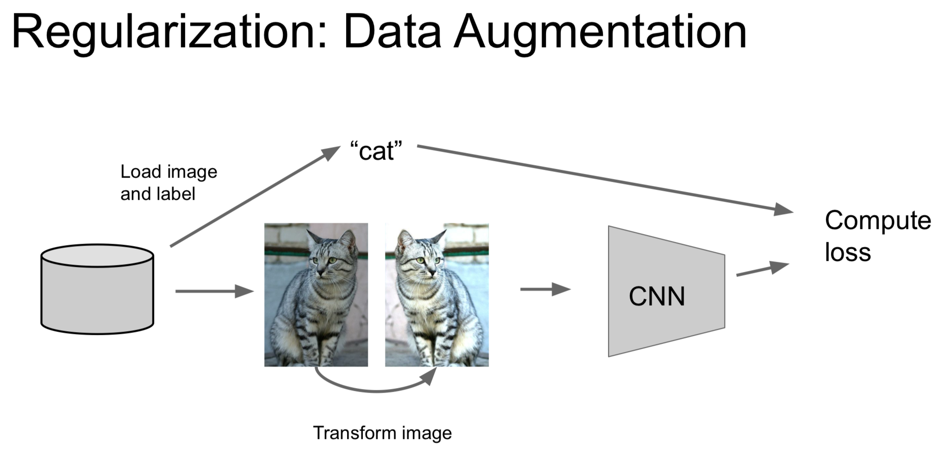

Slide 92


Slide 93


Slide 94


Slide 95


Slide 96


Slide 97
Case Studies
Notes:
Trains ConvNet in the browser
Can load pretrained network
Karpathy = 12+39 minutes up to here (including the demo)

Slide 98
Case Study: LeNet-5
[LeCun et al., 1998]
Conv filters were 5x5, applied at stride 1
Subsampling (Pooling) layers were 2x2 applied at stride 2
i.e. architecture is [CONV-POOL-CONV-POOL-CONV-FC]
Notes:
https://youtu.be/AQirPKrAyDg?t=2757 45:00
32x32 input
5x5, stride 1 filters throughout the architecture
6 filters, subsample (=maxpooling), 16 conv filter

Slide 99

Case Study: AlexNet
[Krizhevsky et al. 2012]
Input: 227x227x3 images
First layer (CONV1): 96 11x11 filters applied at stride 4
=>
Q: what is the output volume size? Hint: (227-11)/4+1 = 55
Notes:
A lot more detail for this network
Input is 227x…
Figure is cropped on the original paper, the same cropped figure appears everywhere
GPUs were not very good at the time of development, so he had to split the conv stream into two
ask

Slide 100
Case Study: AlexNet
[Krizhevsky et al. 2012]
Input: 227x227x3 images
First layer (CONV1): 96 11x11 filters applied at stride 4
=>
Output volume [55x55x96]
Q: What is the total number of parameters in this layer?

Slide 101
Case Study: AlexNet
[Krizhevsky et al. 2012]
Input: 227x227x3 images
First layer (CONV1): 96 11x11 filters applied at stride 4
=>
Output volume [55x55x96]
Parameters: (11*11*3)*96 = 35K
Notes:
In the image, you see 224. But 224 does not fit, so everyone believes that it is 227 instead.

Slide 102
Case Study: AlexNet
[Krizhevsky et al. 2012]
Input: 227x227x3 images
After CONV1: 55x55x96
Second layer (POOL1): 3x3 filters applied at stride 2
Q: what is the output volume size? Hint: (55-3)/2+1 = 27

Slide 103
Case Study: AlexNet
[Krizhevsky et al. 2012]
Input: 227x227x3 images
After CONV1: 55x55x96
Second layer (POOL1): 3x3 filters applied at stride 2
Output volume: 27x27x96
Q: what is the number of parameters in this layer?
Notes:
Trick question

Slide 104
Case Study: AlexNet
[Krizhevsky et al. 2012]
Input: 227x227x3 images
After CONV1: 55x55x96
Second layer (POOL1): 3x3 filters applied at stride 2
Output volume: 27x27x96
Parameters: 0!

Slide 105
Case Study: AlexNet
[Krizhevsky et al. 2012]
Input: 227x227x3 images
After CONV1: 55x55x96
After POOL1: 27x27x96
...
Notes:
This is what we've seen so far, but there are many other layers

Slide 106
Case Study: AlexNet
[Krizhevsky et al. 2012]
Full (simplified) AlexNet architecture:
[227x227x3] INPUT
[55x55x96] CONV1: 96 11x11 filters at stride 4, pad 0
[27x27x96] MAX POOL1: 3x3 filters at stride 2
[27x27x96] NORM1: Normalization layer
[27x27x256] CONV2: 256 5x5 filters at stride 1, pad 2
[13x13x256] MAX POOL2: 3x3 filters at stride 2
[13x13x256] NORM2: Normalization layer
[13x13x384] CONV3: 384 3x3 filters at stride 1, pad 1
[13x13x384] CONV4: 384 3x3 filters at stride 1, pad 1
[13x13x256] CONV5: 256 3x3 filters at stride 1, pad 1
[6x6x256] MAX POOL3: 3x3 filters at stride 2
[4096] FC6: 4096 neurons
[4096] FC7: 4096 neurons
[1000] FC8: 1000 neurons (class scores)
Notes:
Full list. Normalization layer = not used anymore, as it doesn't really give any improvements
Go over the stages col-by-col and then line-by-line. Pay attention to #filters.
Side-note: remember that when you backprop in conv layers, make sure you accumulate the gradients

Slide 107
Case Study: AlexNet
[Krizhevsky et al. 2012]
Full (simplified) AlexNet architecture:
[227x227x3] INPUT
[55x55x96] CONV1: 96 11x11 filters at stride 4, pad 0
[27x27x96] MAX POOL1: 3x3 filters at stride 2
[27x27x96] NORM1: Normalization layer
[27x27x256] CONV2: 256 5x5 filters at stride 1, pad 2
[13x13x256] MAX POOL2: 3x3 filters at stride 2
[13x13x256] NORM2: Normalization layer
[13x13x384] CONV3: 384 3x3 filters at stride 1, pad 1
[13x13x384] CONV4: 384 3x3 filters at stride 1, pad 1
[13x13x256] CONV5: 256 3x3 filters at stride 1, pad 1
[6x6x256] MAX POOL3: 3x3 filters at stride 2
[4096] FC6: 4096 neurons
[4096] FC7: 4096 neurons
[1000] FC8: 1000 neurons (class scores)
Commonly used as feature representation
Notes:
First popular use of ReLU
Go line by line
Heavy data augmentation -- we'll talk about this later
DropOut of 0.5
Manual learn rate tweak

